Slide 1
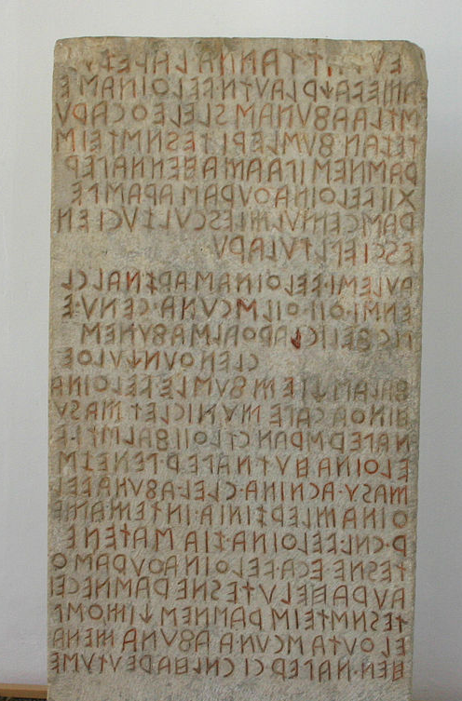
Prehistory
Period prior to that for which written records exist
Fabius Pictor, c. 200 BCE
Lots of texts written before this
Archaeology vs. language
i.e. languages are not peoples
Cippus Perusinus,
3rd-2nd cen. BCE

Slide 2
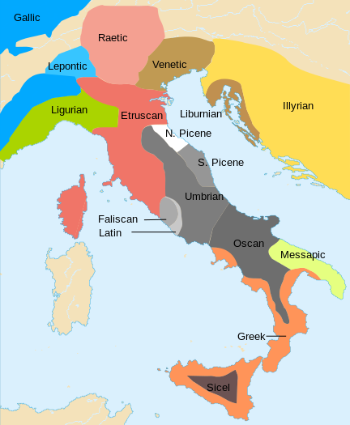
Ancient Italian Languages
Etruscan
Italic languages
Oscan
Umbrian
Faliscan
Latin
Greek
Languages of Italy, c. 650 BCE

Slide 3
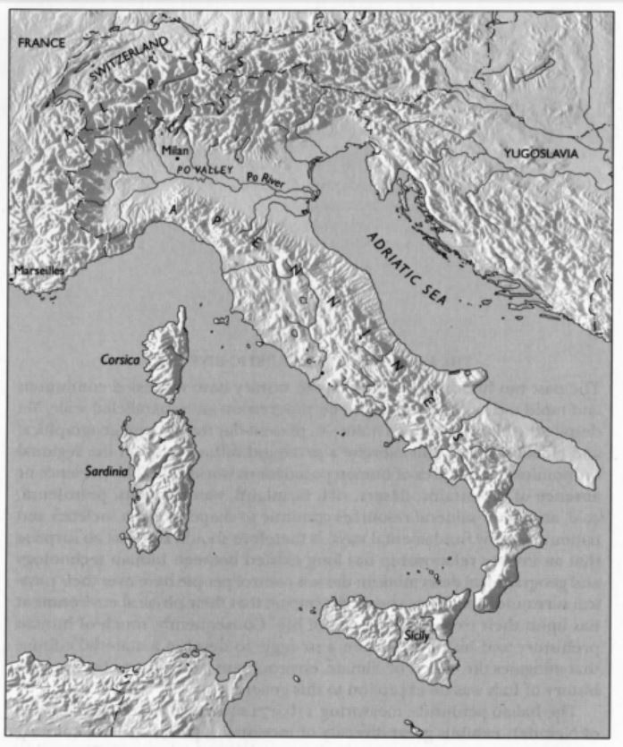
Geography
Po River Valley
AKA ‘Cisalpine Gaul’
Italian peninsula
Apennine Mountains
Islands
Sicily
Sardinia
Corsica

Slide 4
Geography
Etruria
Latium
Campania

Slide 5
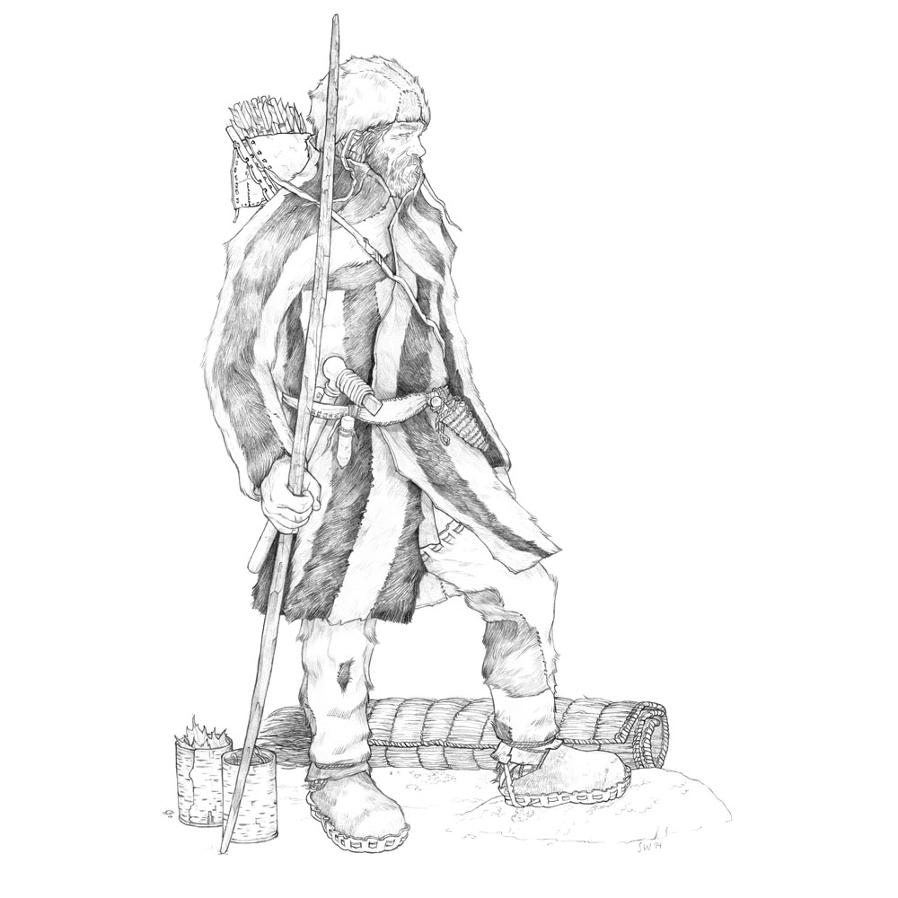
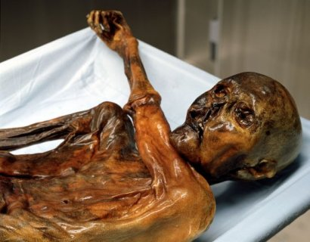
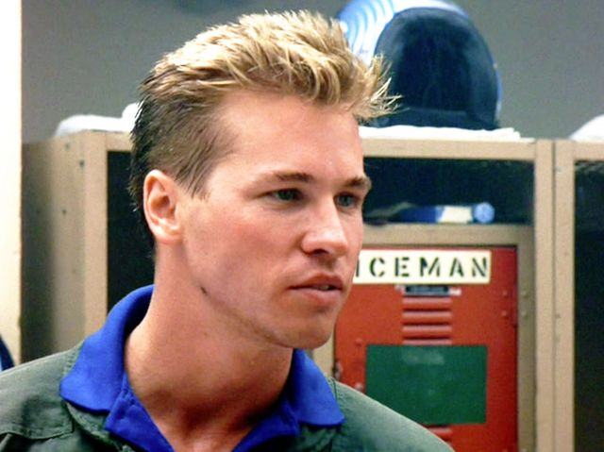
Ötzi the Iceman
Naturally mummified body found in the Italian Alps in 1991
Lived c. 3500-3000 BCE
Leather boots, fur-lined coat, grass cape, yew bow, 14 arrows, flint knife, backpack made of wood and bark, unworked flint
5’ 2”, 110 lbs., about 45 years old, bearded, 61 tatoos
Wounded a few days before his death, and probably caught in snowstorm while crossing the Alps in the late summer or early autumn
*

Slide 6
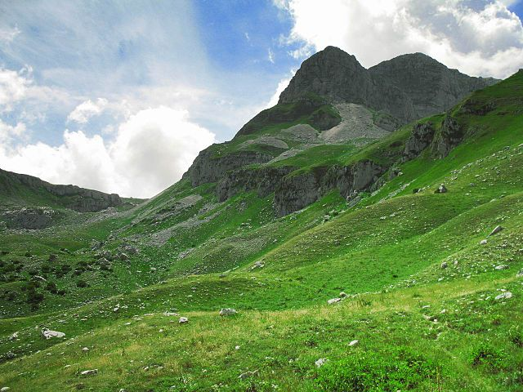
The Bronze Age
Bronze = alloy of copper and tin
Replaces flint c. 2000 BCE as the primary material for tools and weapons
Most settlements located in central highland region
Hence the ‘Apennine culture’
Economic activity focused largely on pastoralism
Inhumation practiced

Slide 7
The Bronze Age
Po River Valley
AKA ‘Cisalpine Gaul’
Greater focus on agriculture
Cremation practiced
Links with northern Europe across the Alps
Especially the Urnfield culture

Slide 8
The Iron Age
Iron replaces bronze beginning c. 900 BCE
Stronger contacts with peoples from the eastern Mediterranean
Development of several distinctive cultural groups

Slide 9
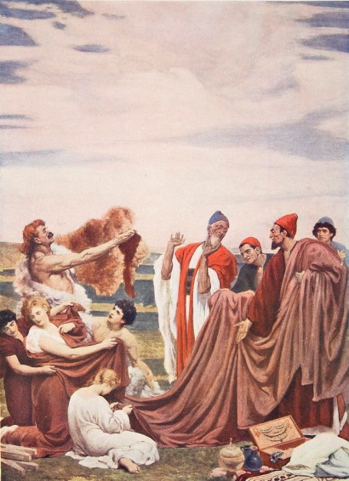
The Phoenicians
Semitic people from Phoenicia in the Levant (modern Lebanon)
Region famed for ‘Cedars of Lebanon’
Known primarily as seaborne merchants
Especially active c. 1000-600 BCE
Established trading colonies through the Mediterranean
Including Carthage in the mid 8th cen. BCE
Frederic Leighton, Phoenicians Trading with the Early Britons on the Coast of Cornwall (1895)

Slide 10
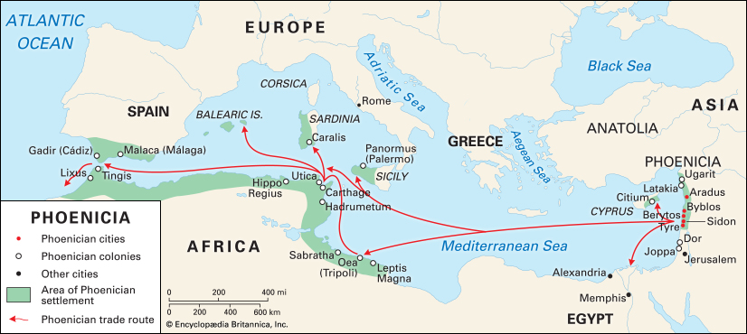
The Phoenicians

Slide 11
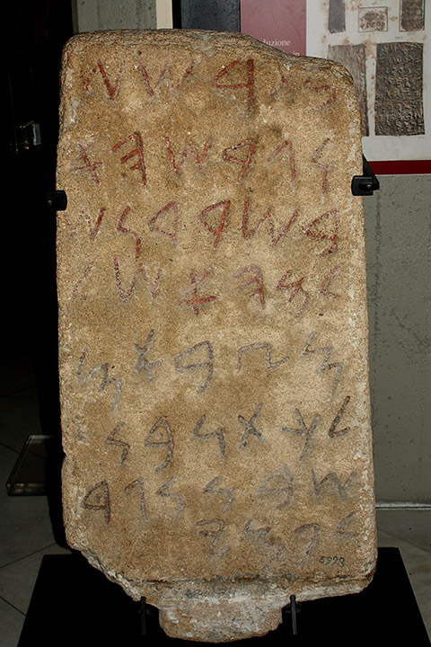
The Nora Stone
From Sardinia
c. 9th-8th cen. BCE
Phoenician inscription commemorating destruction of a village:
“A house he beat down. And he drove out. In Sardinia, he is at peace; his army is at peace. Milkyton, son of Shubon, the Commander. For Pummay.”
*

Slide 12
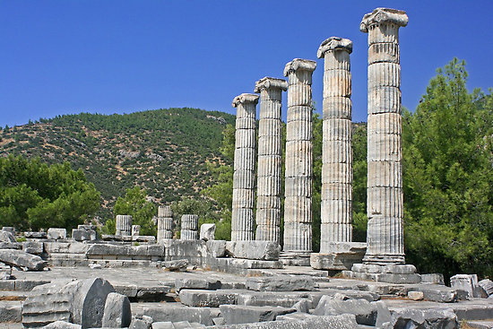
Greek City-States
‘Polis’ in Greek
Sovereign cities and their territories
Forms of governance:
Tyranny
Oligarchy
Democracy
Each polis founded new semi-independent poleis as colonies
And some colonies founded their own colonies

Slide 13
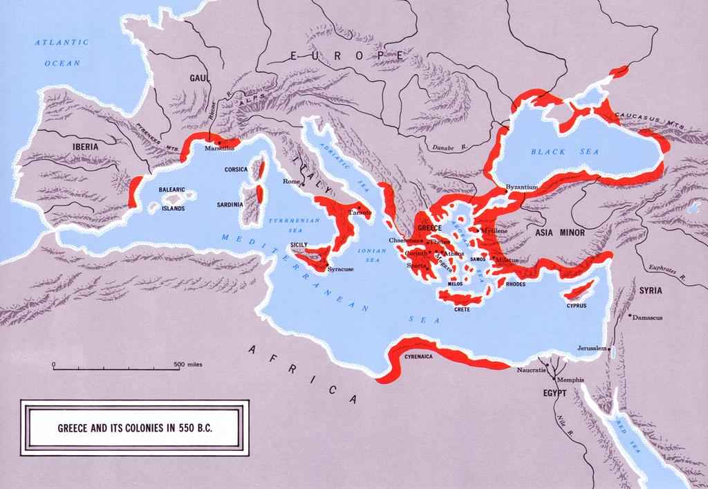
Greek Colonization

Slide 14
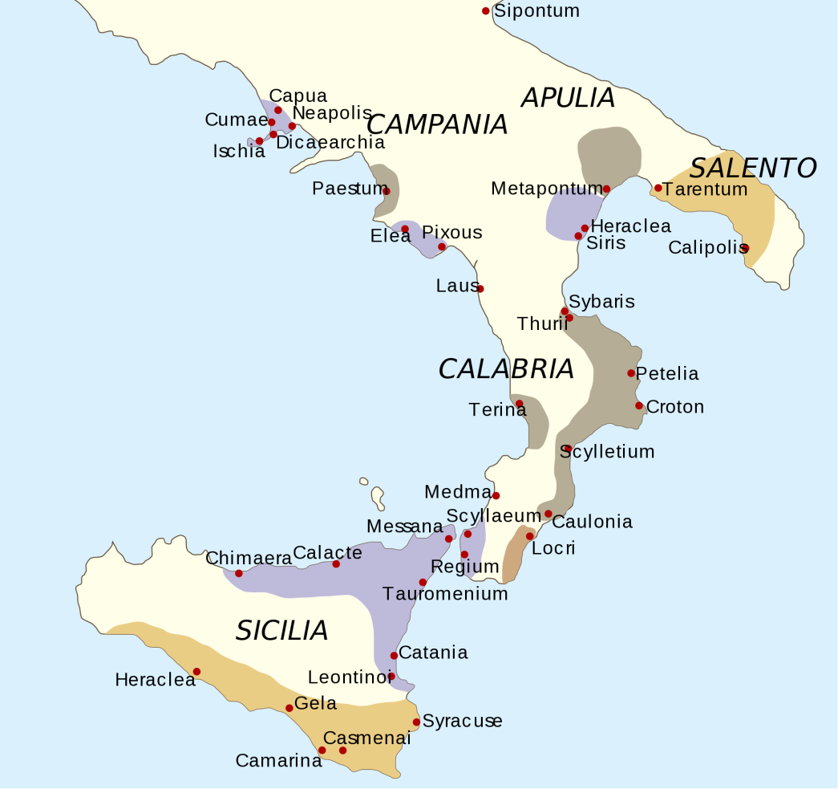
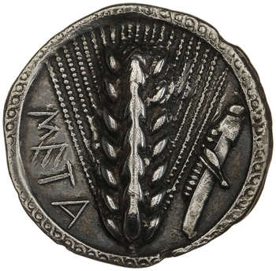
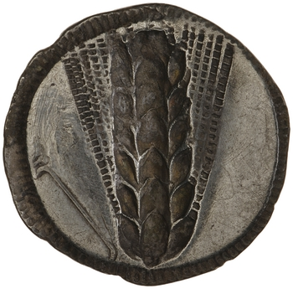
Magna Graecia
‘Great Greece’
Colonies established beginning in the 8th cen. BCE
Some for trade
e.g. Pithecusae
Some for settlement and agriculture
e.g. Metapontum
Brought Greek religion, language and practices to Italy
Silver stater of Metapontum, c. 530-510 BCE

Slide 15
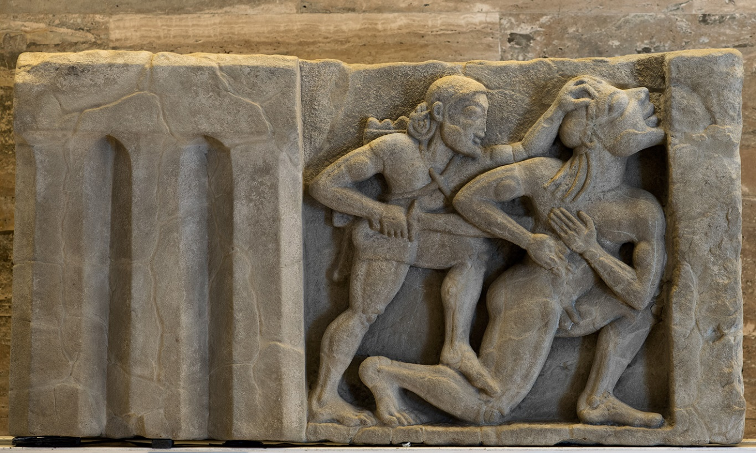
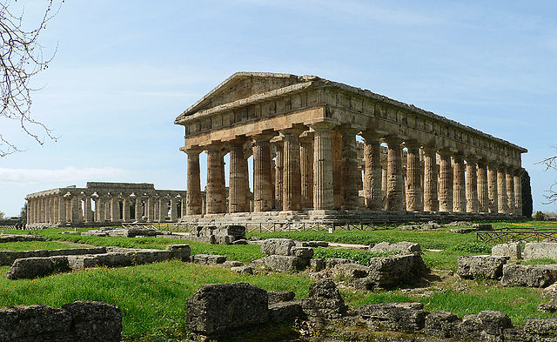
Paestum
Colony founded by Sybaris in the late 7th cen. BCE
Three temples constructed by the mid 6th cen. BCE
Overrun by Lucanians at the end of the 5th cen. BCE

Slide 16
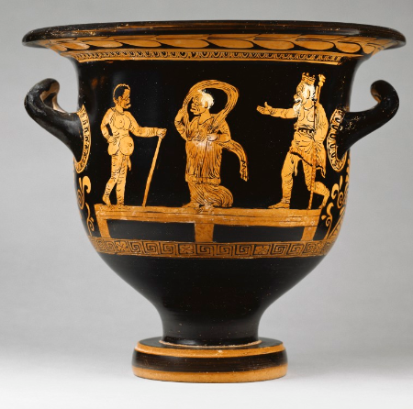
Apulian Red-Figure Pottery
Dates from the 4th cen. onwards
Derived from Athenian red-figure pottery of the 5th cen.
Often depicts mythological or theatrical scenes
Red-figure Bell Krater, c. 370-360 BCE

Slide 17
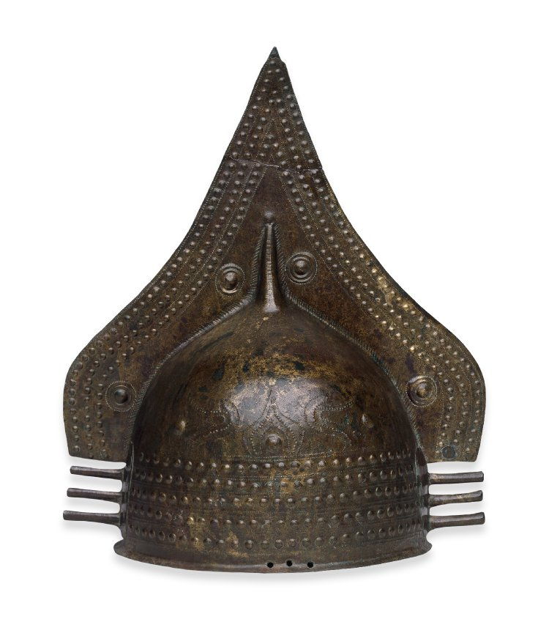
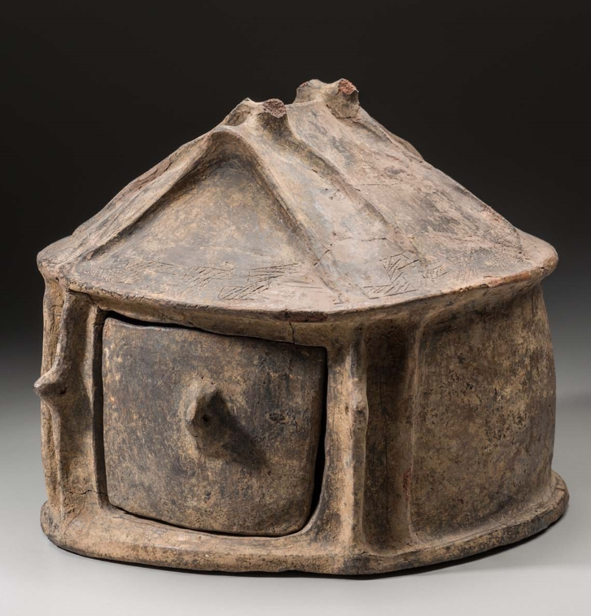
The Villanovan Culture
Iron Age culture in northwestern Italy, c. 900-700 BCE
Accomplished metalworkers
Rich copper and iron mines attracted Greek and Phoenician traders
Practiced cremation and made ceramic urns in the shape of huts
Direct precursor to the Etruscans
*
Terracotta hut urn, c. 900 BCE

Slide 18
Vocab!
Inhumation
Burial of the deceased
Cremation
Burning the deceased until only ashes remain
Terracotta
‘Baked earth,’ i.e. ceramic

Slide 19
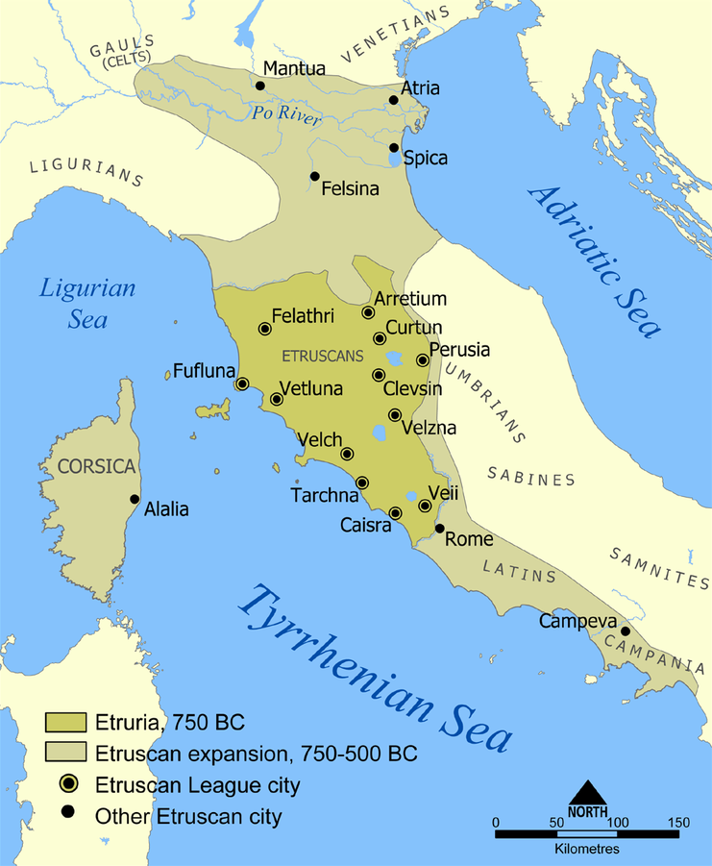
The Etruscans
Begin c. 8th cen. BCE
Spoke a non Indo-European language (Etruscan)
We can’t read it!
Originally lived in Etruria, but expanded northward into the Po River Valley and south as far as Campania
Never politically united; each city was independent and had its own king

Slide 20
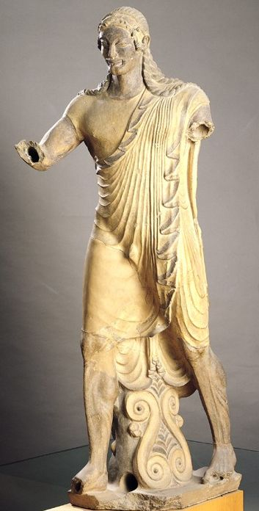
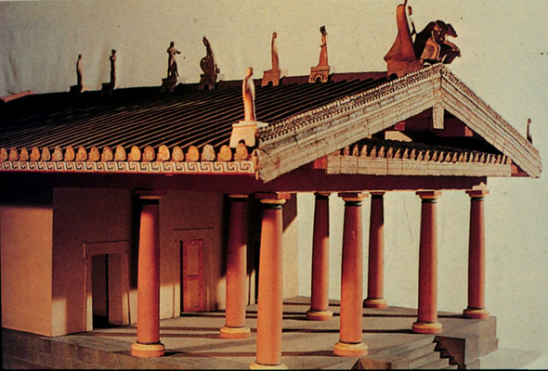
Etruscan Temples
Temple of Minerva at Veii, near Rome (the Portonaccio Sanctuary)
c. 510-500 BCE
Made of wood and mudbrick
Little survives, but was described by the Roman architect Vitruvius
Sculptural roof decorations
Etruscans built the first Temple of Jupiter in Rome
Model of the Portonaccio Sanctuary
The Portonaccio Apollo

Slide 21
Etruscan Tombs
Etruscans practiced both cremation and inhumation
Major cemeteries at Cerveteri/Caere and Tarquinia

Slide 22
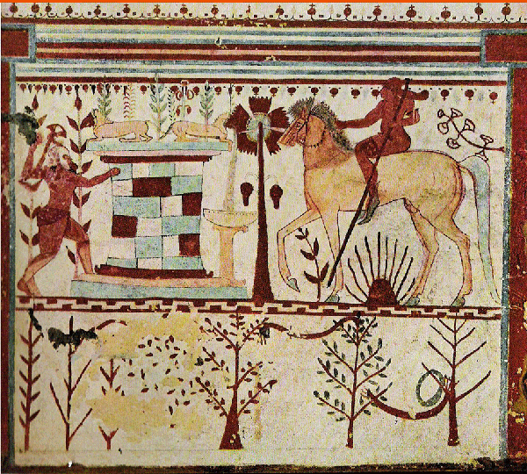
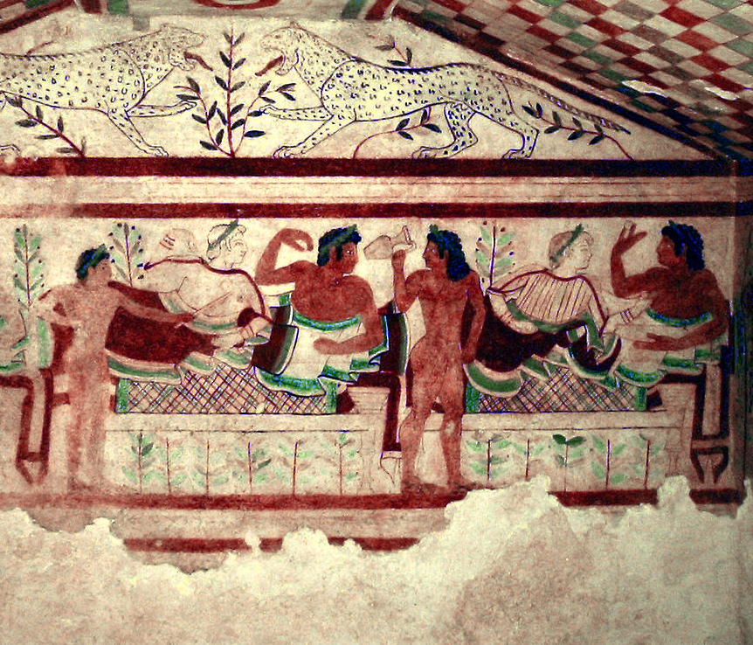
Tomb Paintings
*
Tomb of the Bulls, near Tarquinia, c. 540-520 BCE
Tomb of the Leopards, near Tarquinia, c. 480-450 BCE

Slide 23
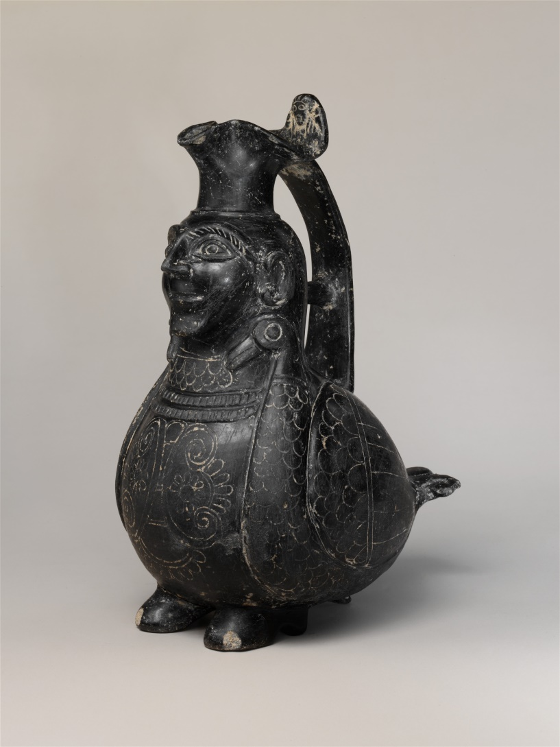
Etruscan Bucchero Pottery
Type of black burnished pottery made by the Etruscans
Incised decoration
Meant to resemble metal vessels
Mostly found in tombs, but also at settlement sites
Etruscan bucchero jug, c. 550-500 BCE

Slide 24
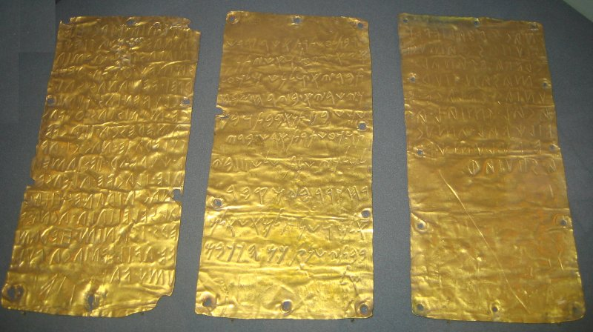
The Pyrgi Tablets
To Lady Astarte is dedicated this shrine which Thefarie Velianas, king over Caere, constructed, and which he donated in the month of Sacrifices to the Sun as a gift in the temple. And I built it because Astarte requested it from me in the third year of my reign in the month of Krr on the day of the burial of the deity. And may the years of the statue of the deity in her temple be years like the stars of El!
*
The Pyrgi tablets, c. 500 BCE

Slide 25
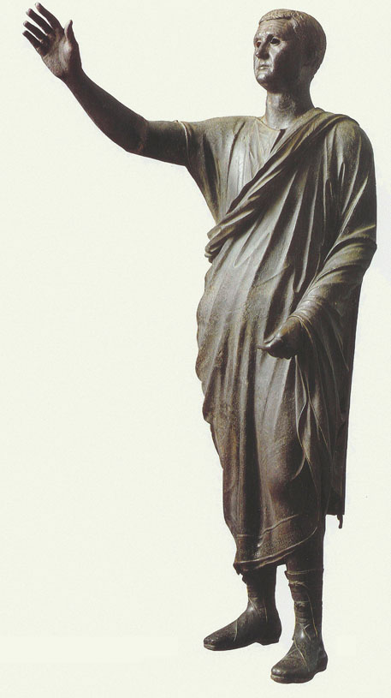
The Orator
*
Life-sized bronze statue
c. 100 BCE
Found near Perugia in northwestern Italy in 1566
Etruscan inscription on the toga identifies it as Aulus Metellus
Gesturing for silence before making a speech

Slide 26
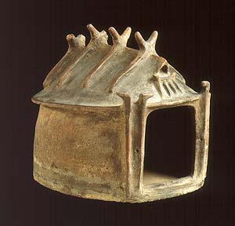
The Latins
Centered in Latium in central Italy
‘Latial culture,’ c. 1000-600 BCE
Spoke Old Latin
Not politically unified; each city was independent
Came to be dominated by Rome as early as the 7th cen. BCE
Terracotta hut urn, c. 900 BCE

Slide 27
The Bronze Age
Apennine Culture
Po River Valley

Slide 28
The Iron Age
Increased contact with eastern Mediterranean
Development of Villanovan and Etrsucan culture in the north
Greek colonization in the south
Villanovan
Culture
Etruscans
Latins
Greeks
Phoenicians

Slide 29
Ancient Italian Languages
Etruscan
Italic languages
Oscan
Umbrian
Faliscan
Latin
Greek
Languages of Italy, c. 650 BCE

Slide 30
Key Terms
Etruria
Campania
Latium
Ötzi
Inhumation
Cremation
Terracotta
Phoenicians
Magna Graecia
Villanovan culture
Bucchero
The Pyrgi tablets

